Slide 1
AIRLINE DATA ANALYTICS FOR AVAITION INDUSTRY
TEAM ID: PNT2022TMID26752
Team members
1.GOKUL .D- 310519104040
2.GOKUL .K - 310519104041
3.BHARATH .J- 310519104025
4.BALAMURUGAN .R - 310519104022

Slide 2
AGENDA
IDEATION
DESIGN PHASE 1
DESIGN PHASE 2
DEVELOPMENT PHASE
WORKING WITH DATASET
DATA VISUALIZATION
CONCLUSION

Slide 3
OBJECTIVES
In this project, we analysed the dataset, visualize the data, define terms, and give further examples for the aviation industry to analysed data from every channel, such as to develop a distinctive customer profile based on a wide variety of demographic information, habits, and preferences
The platform offers decision-support tools for civil aviation, such as maintenance plans, real-time alerts, health monitoring fuel-saving strategies, and flight schedules.

Slide 4
ABSTRACT
The goal is to provide airports, airlines, and the general public to view the delay of flights to the destination which may occur due to climatic conditions to make the passengers aware of the arrival of flights.
Airport codes can refer to either the IATA airport code, a three-letter code used in passenger reservation, ticketing, and baggage-handling systems, or the ICAO airport code, a four-letter code used by ATC systems and for airports without an IATA airport code.
At the municipal level, to provide better airline and airport services and to avoid delays in air travel across different location

Slide 5
IDEATION PHASE
Literature survey : The paper introduces the architecture of the platform and present application to show how the platform facilitates civil aviation
Reference 1 : Mohamed et al. have studied the pattern of arrival delay for non-stop domestic flights at the Orlando International Airport. They focused primarilyonthecyclic variations that happen in the air travel demand and the weather at that particular airport
Reference 2 : In Shervin et al.’s work , their motive of research is to propose an approach that improves the operational performance without hampering or effecting the planned cost

Slide 6
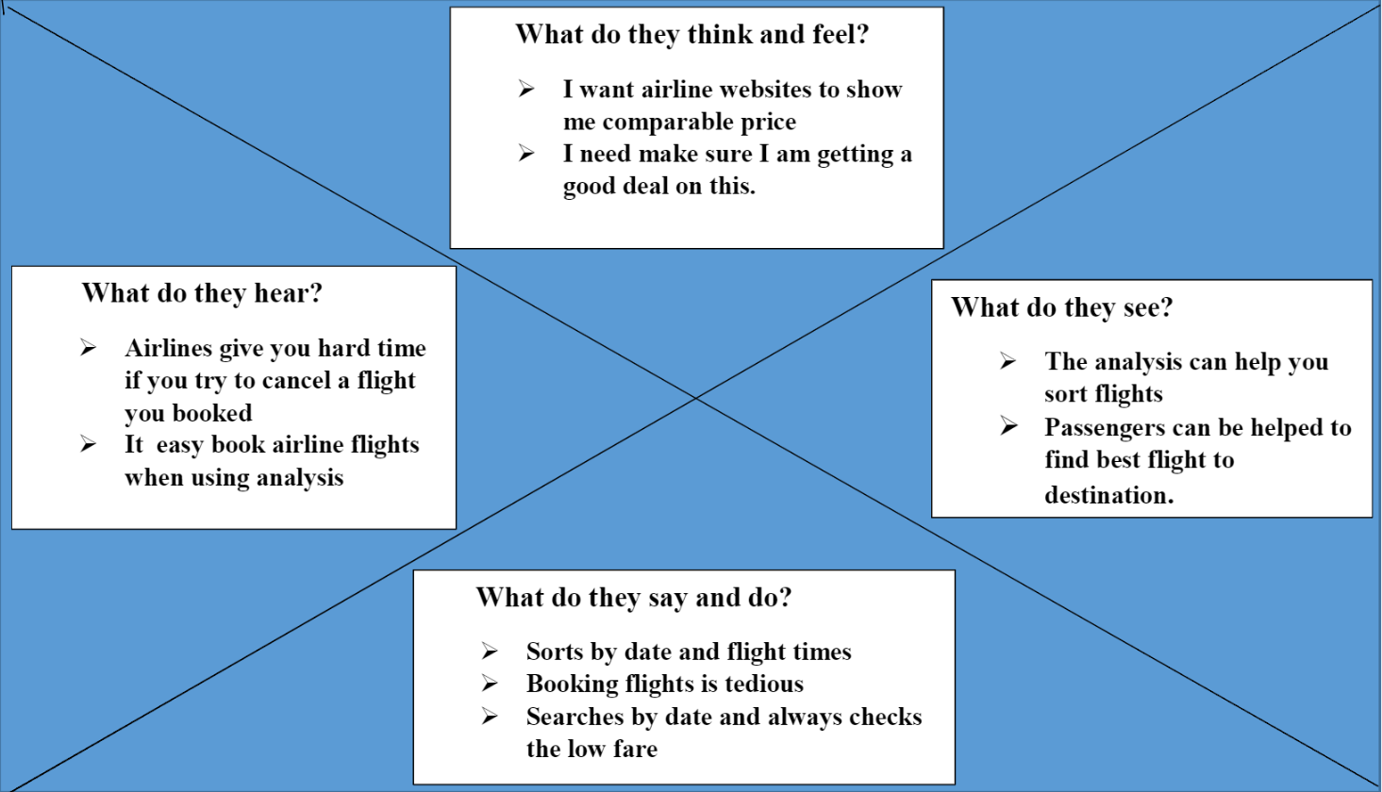
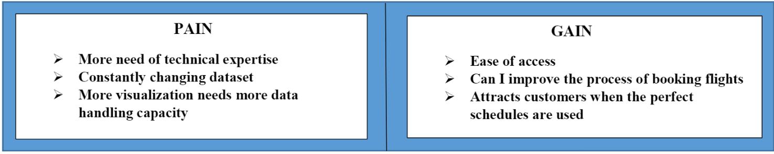
EMPATHY MAP

Slide 7
DESIGN PHASE-I
Proposed Solution :Due to the use of the smart data analytics passengers will avoid many issues with baggage tracking.
Problem Solution Fit : The motive is to propose an approach that improve the operational performance
Solution Architecture : It process big data processing and aviation big data repository using Cognos Analytic

Slide 8
DESIGN PHASE II
Functional requirement : Using IBM Cognos analytics user can visualize if any delay of flights Registration can done through Gmail and User can view the delay of flights report
Non Functional requirement : user can easily understand and use the features in an effective manner ,wide range of user can make access of the website and user can access at anytime .The system shall be available 24 hours a day 7 days a week

Slide 9
WORKING WITH THE DATASET
Understanding the Dataset
Loading of Dataset
Data Presentation
Joining of Tables
Exploration of Data

Slide 10
DATA VISUALIZATION
Representation of Flight Count By categories
No of Flight Countries Region and Airports
Continent Wise Airports With Types
Country Wise Airports Types
Dashboard Showing Count Of Flights By Types,Countries
and Continent

Slide 11
CONCLUSION
Understanding traveler demand for specific cities and pricing flights can be done using data analytic.
It can be used to predict future glitches prevent them from happening and make the maintenance procedure more accurate, after analyzing the data, a lot of insights have been generated.
Most of the delays and cancellations are due to three main reasons which are stated as weather, Airlines carrier issues and the nation air system.
GITHUB : https://github.com/IBM-EPBL/IBM-Project-29334-1660124182

Slide 12
THANK YOU

